Slide 1




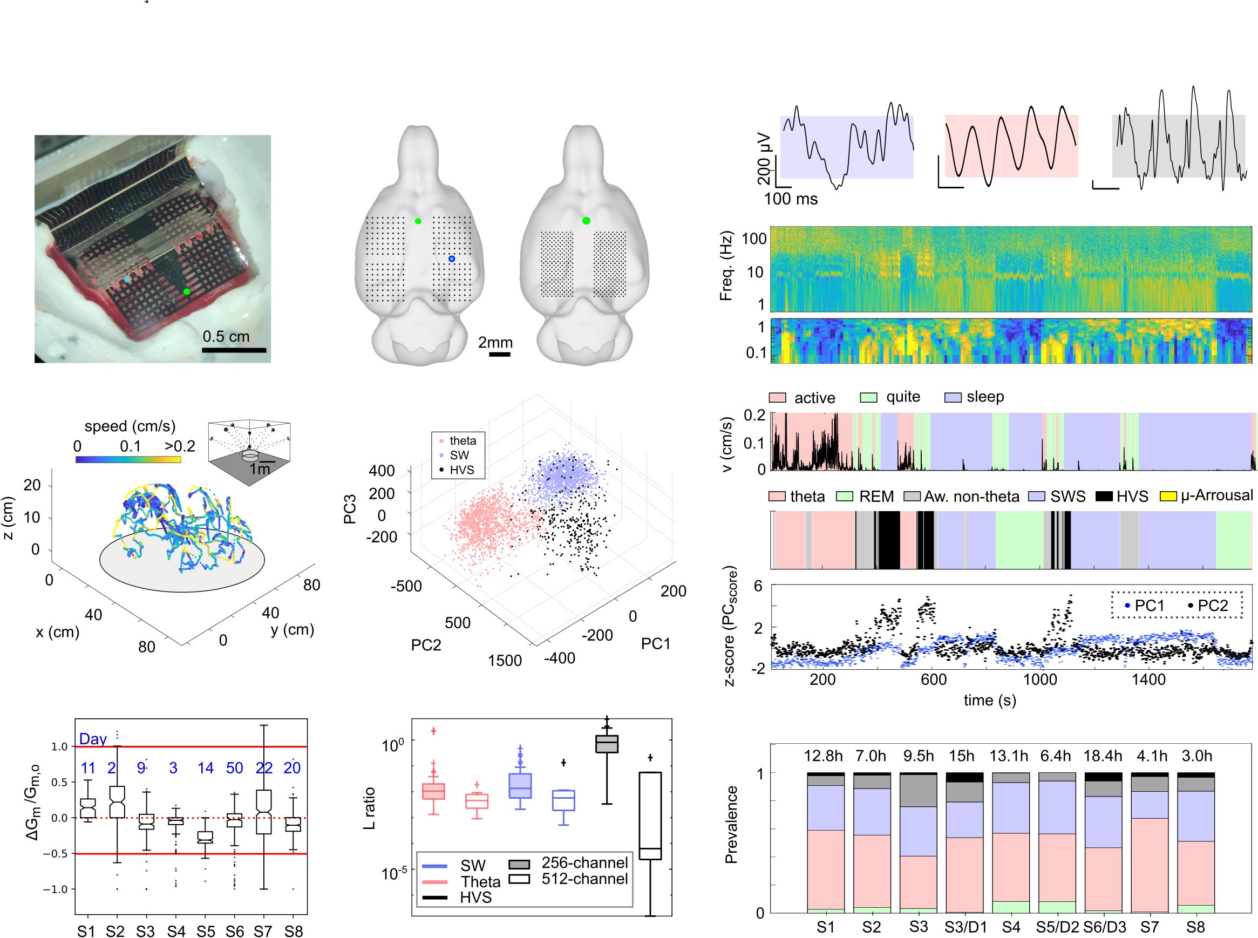
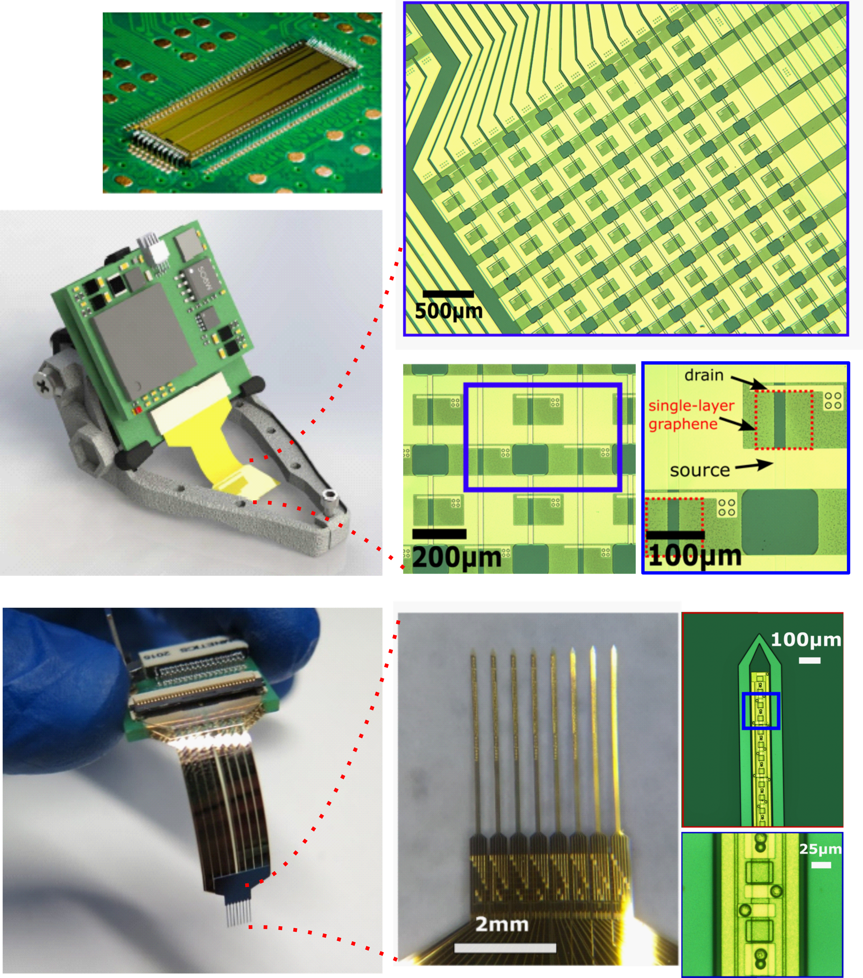
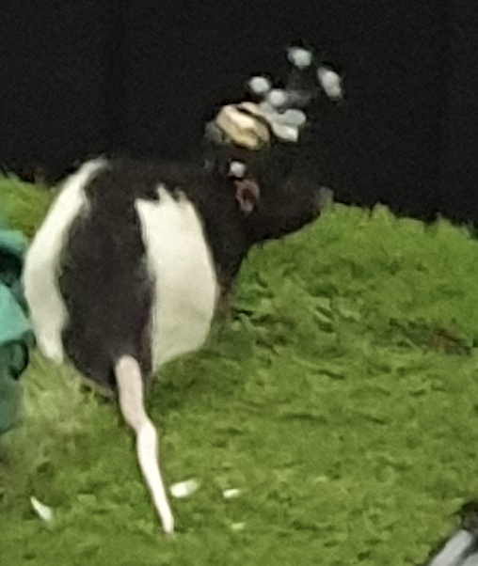
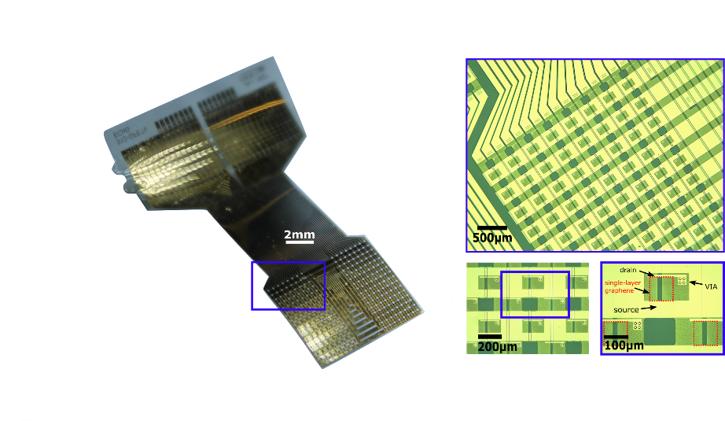
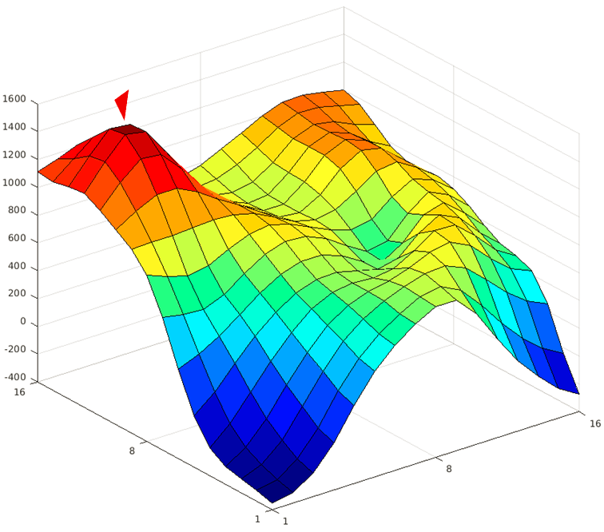
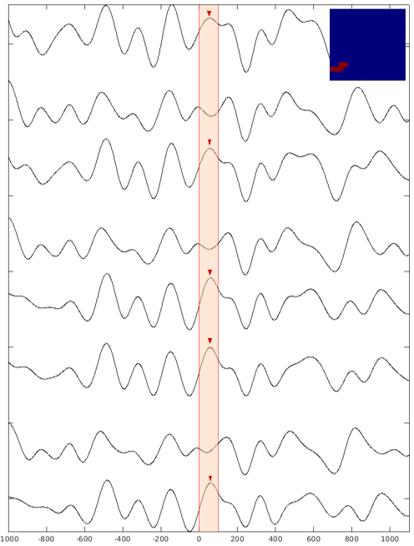
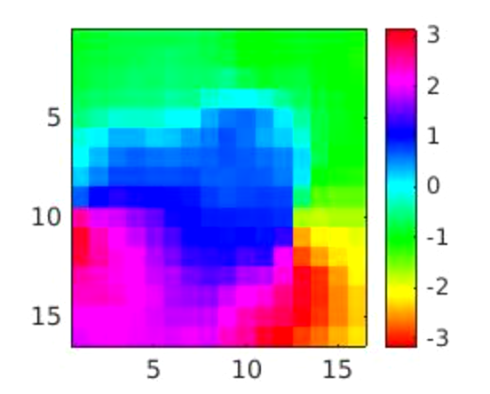
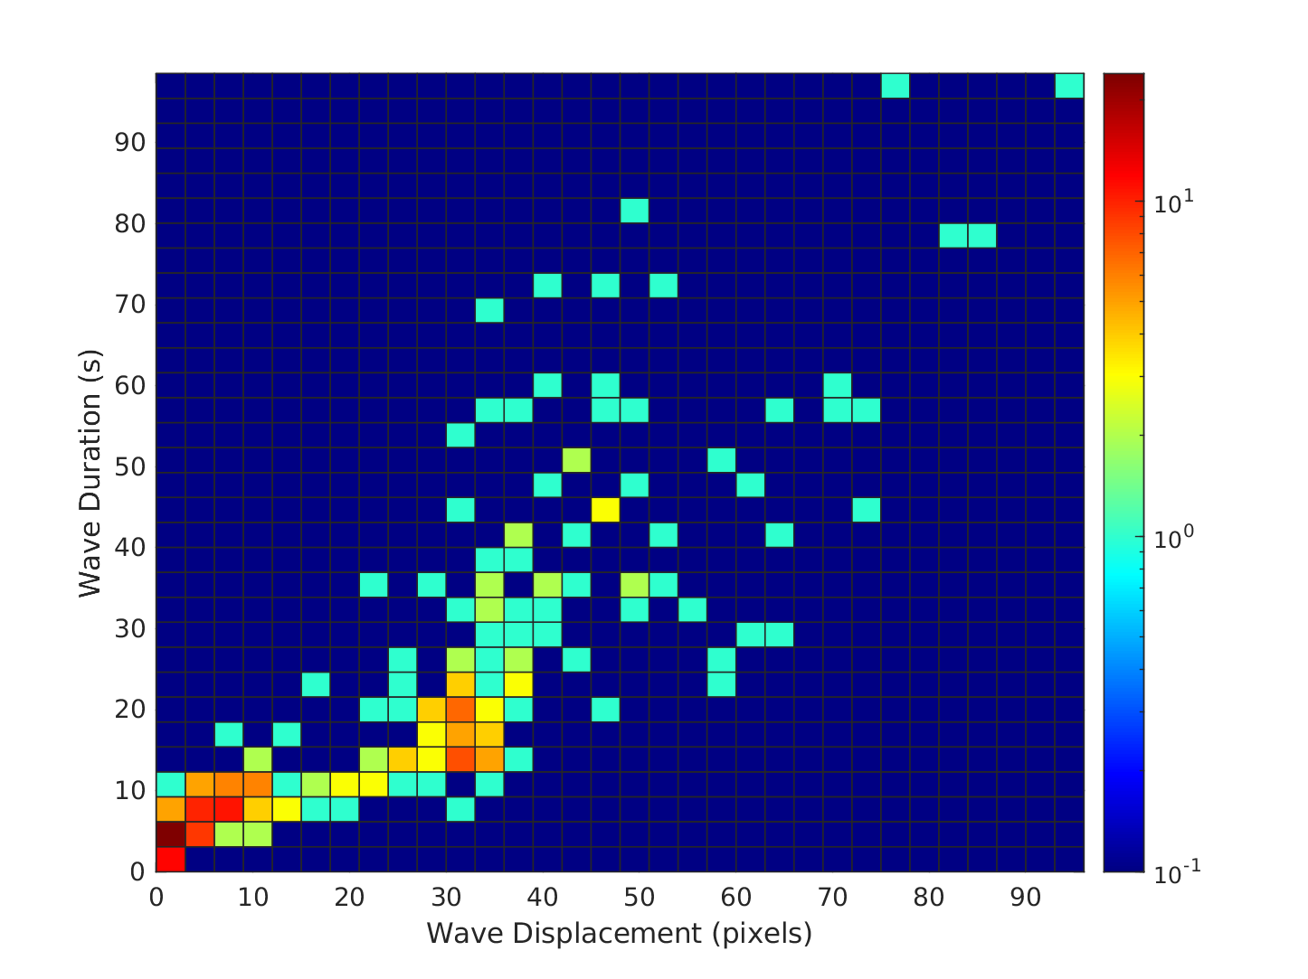
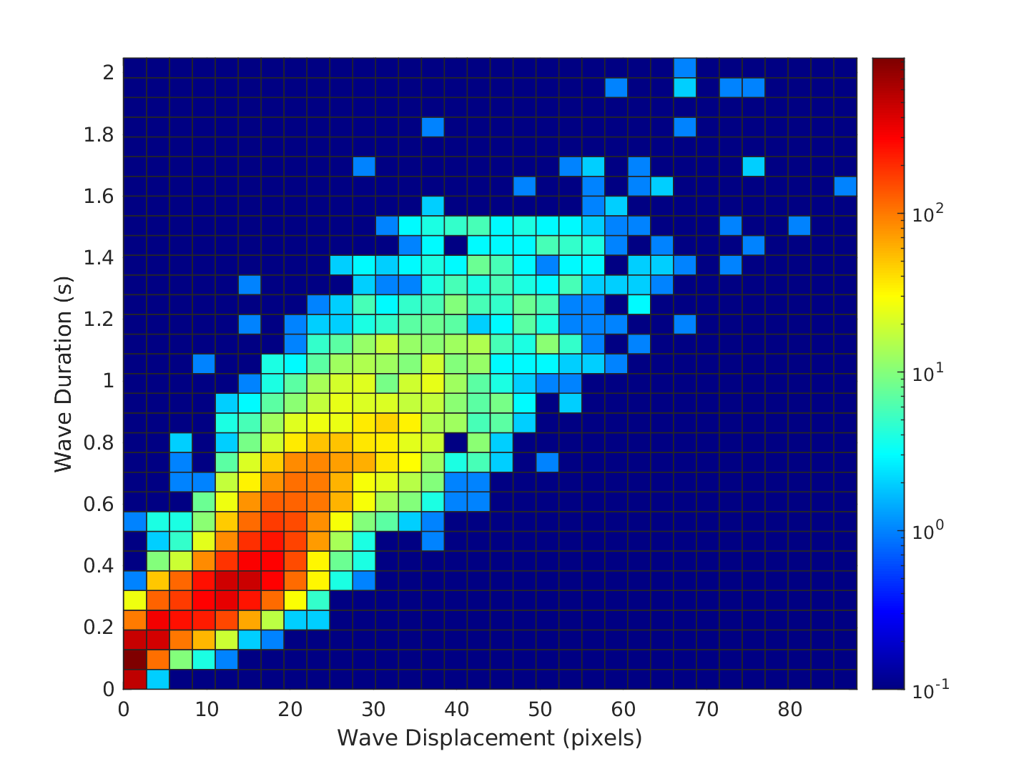
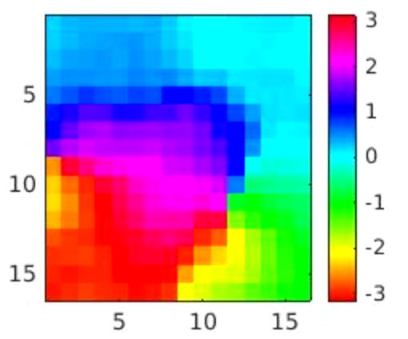
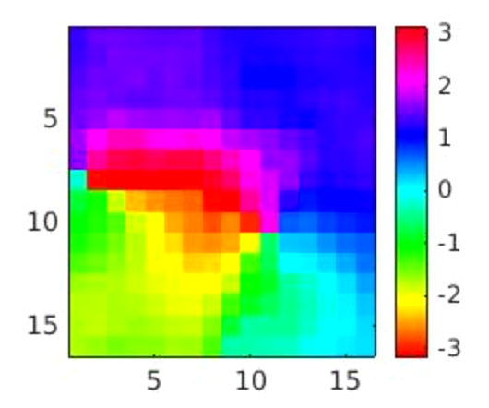
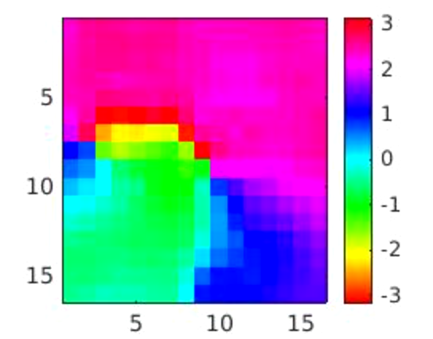
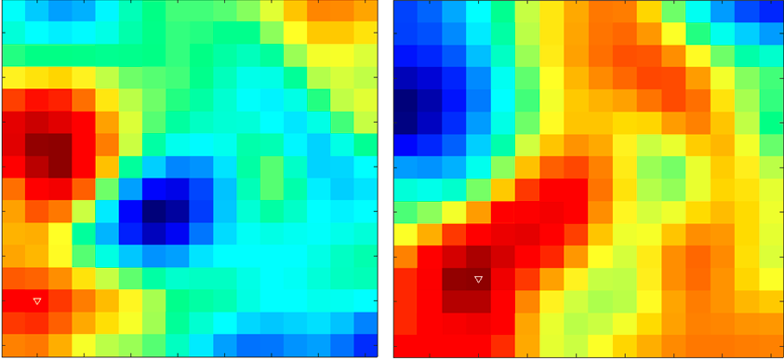
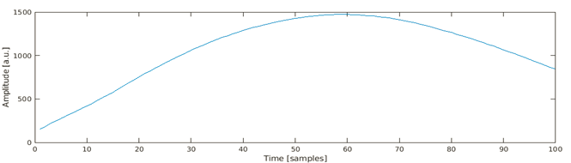
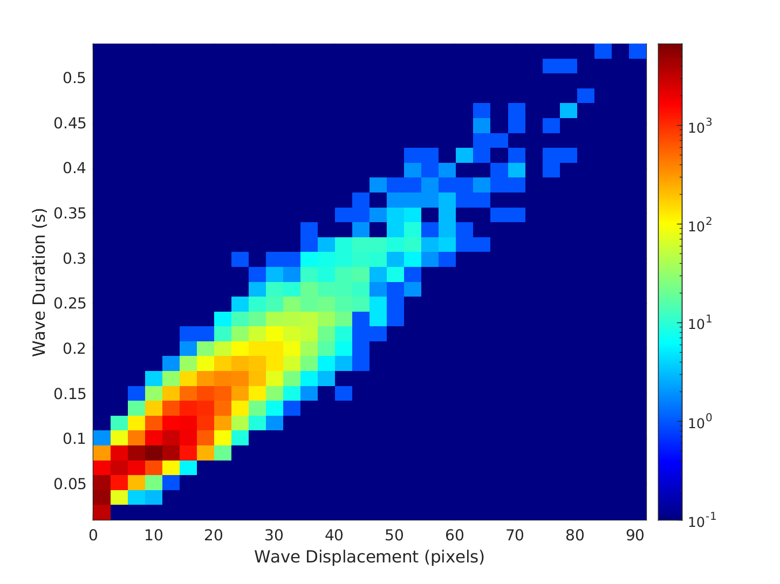
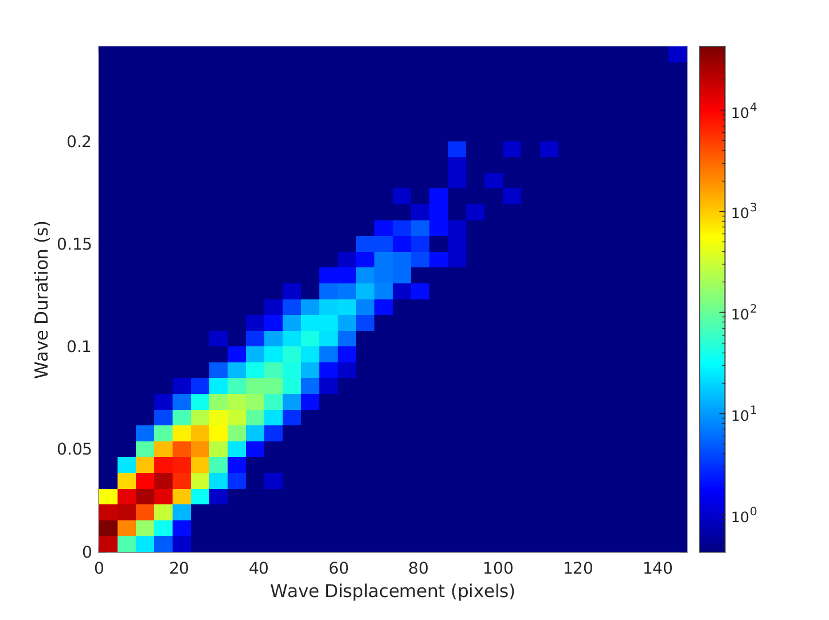
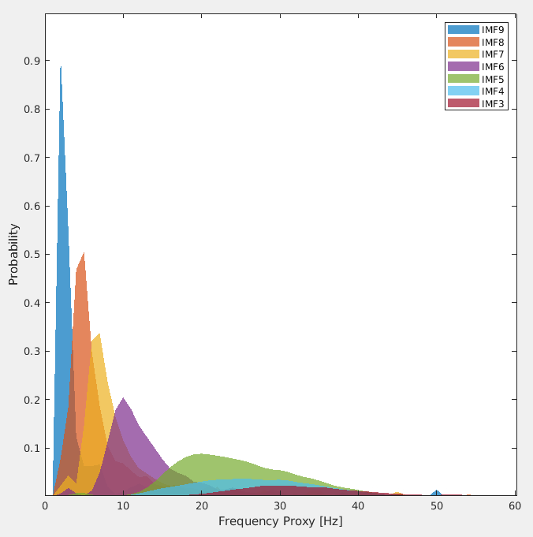
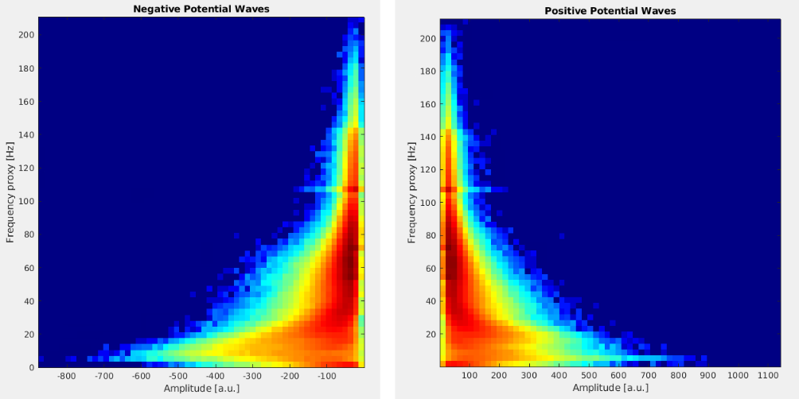
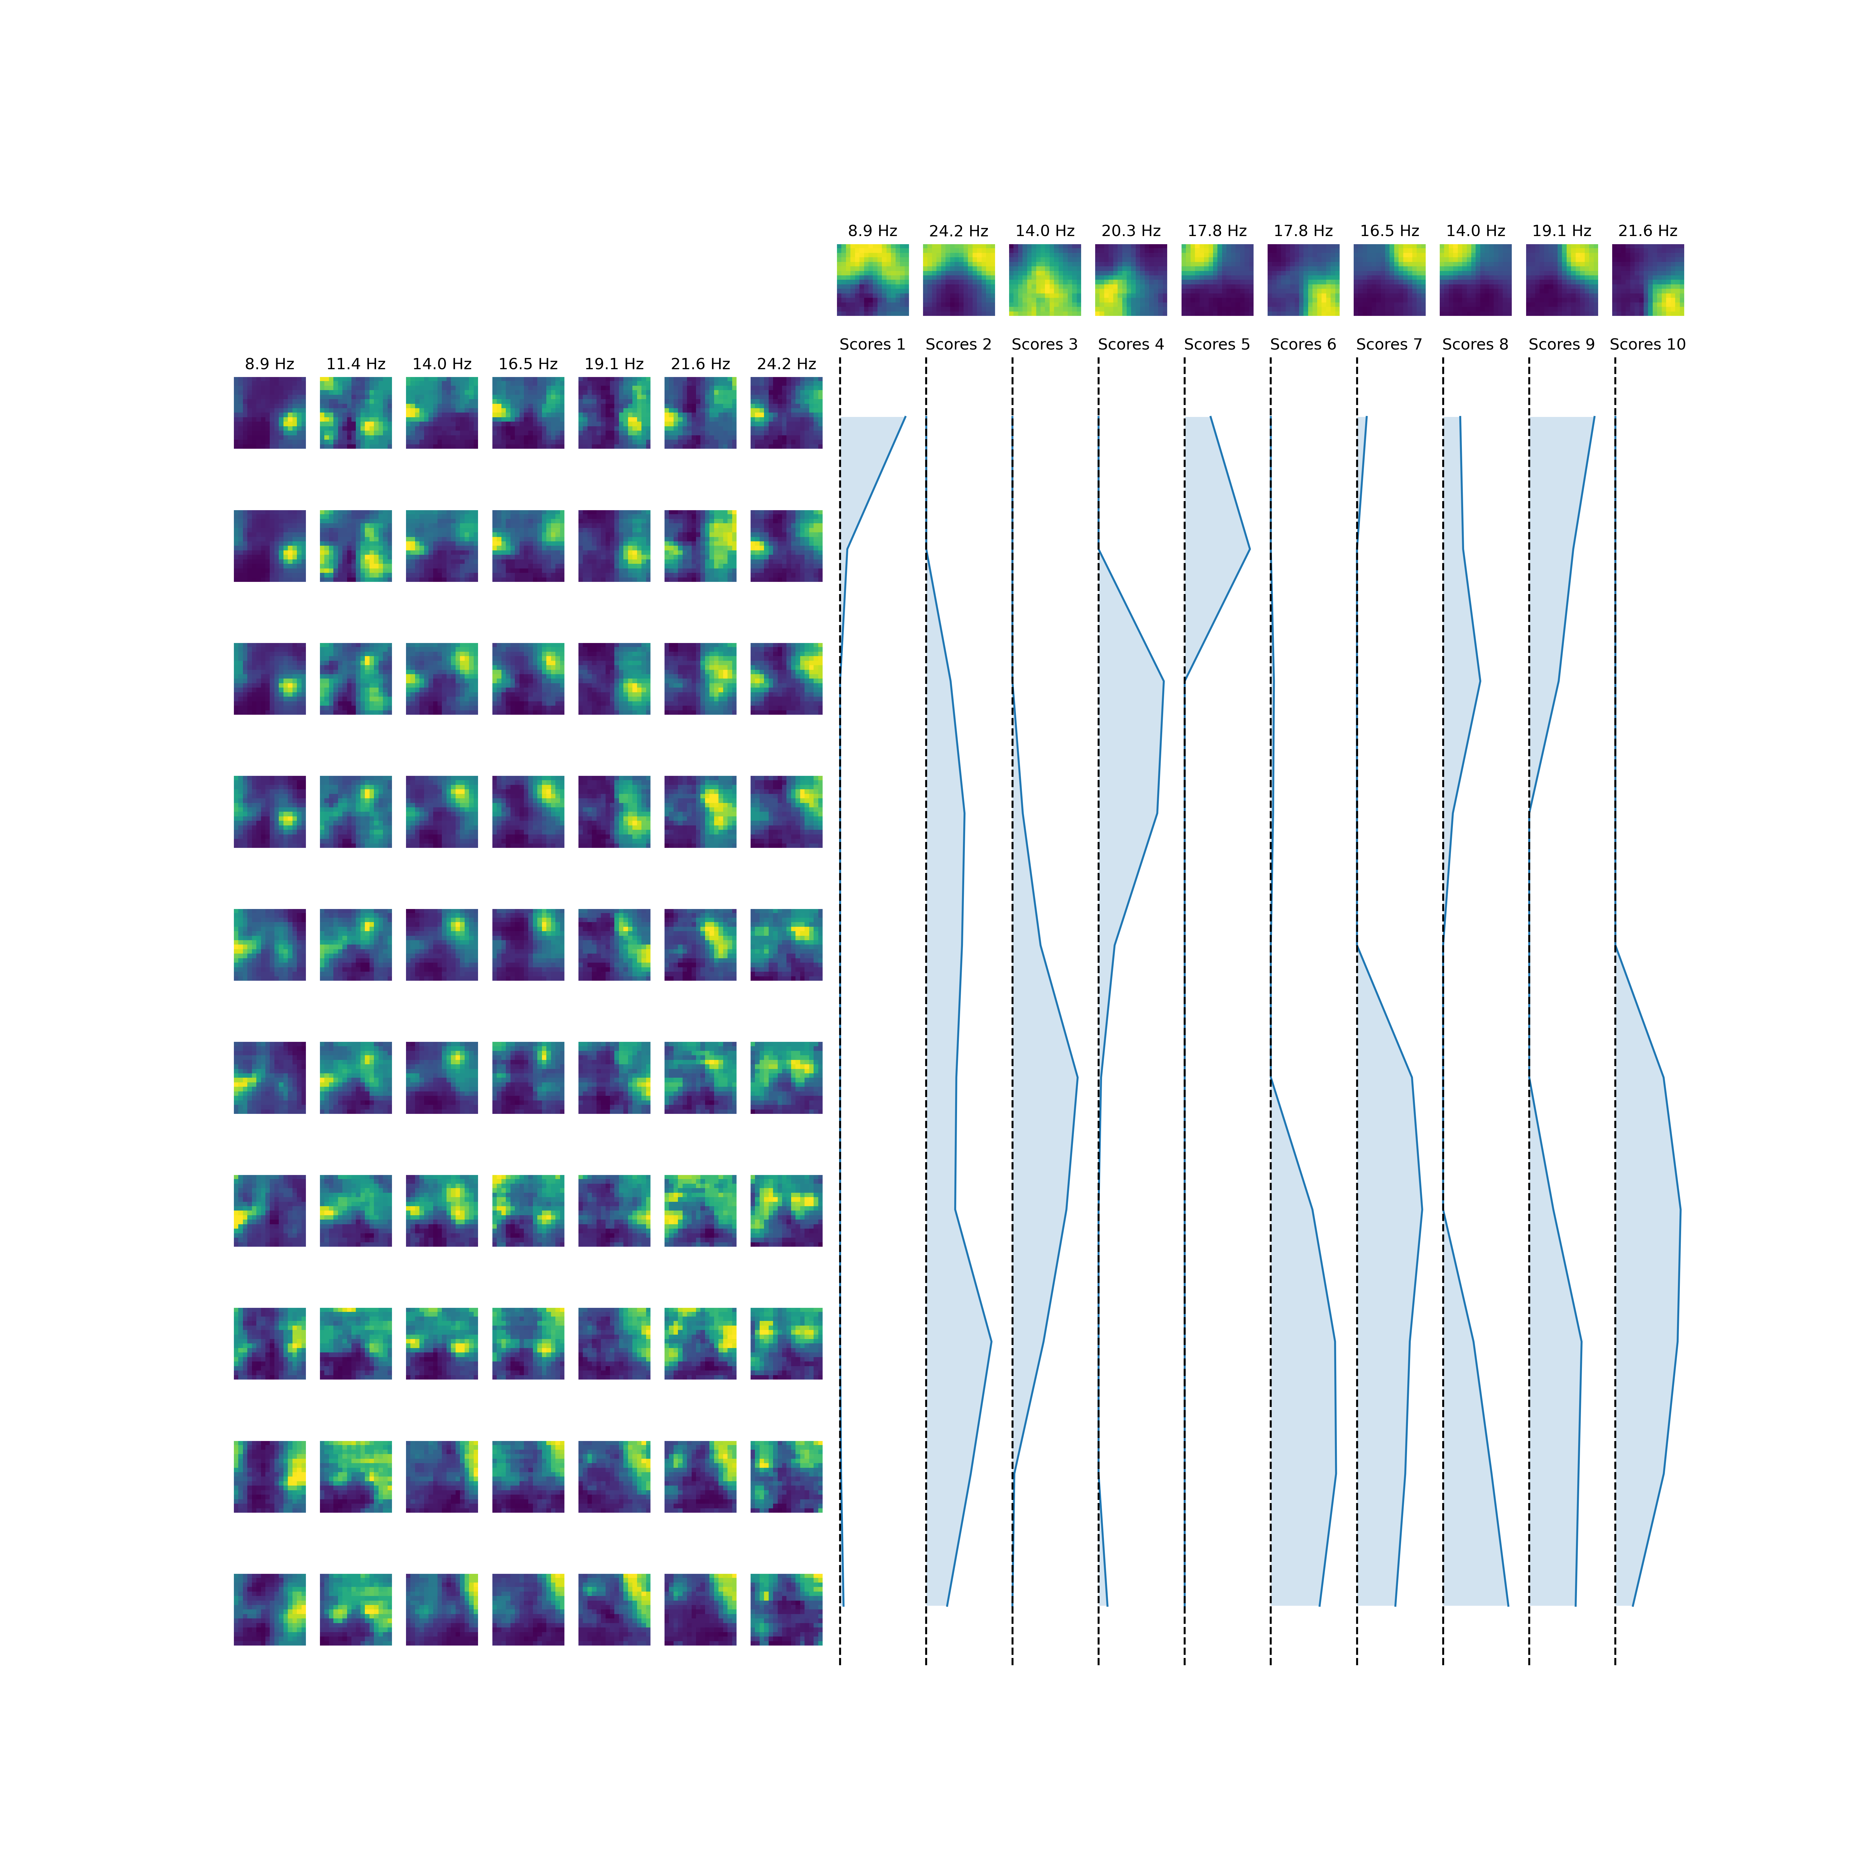
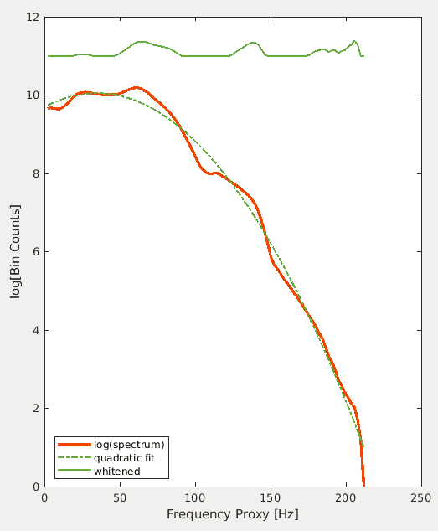
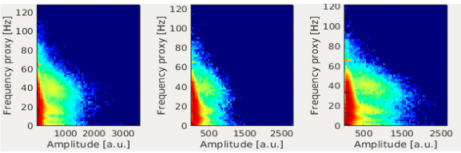
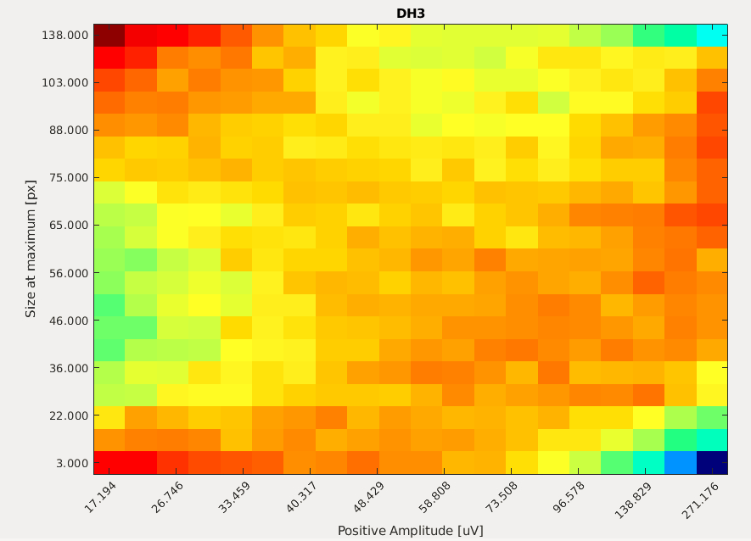
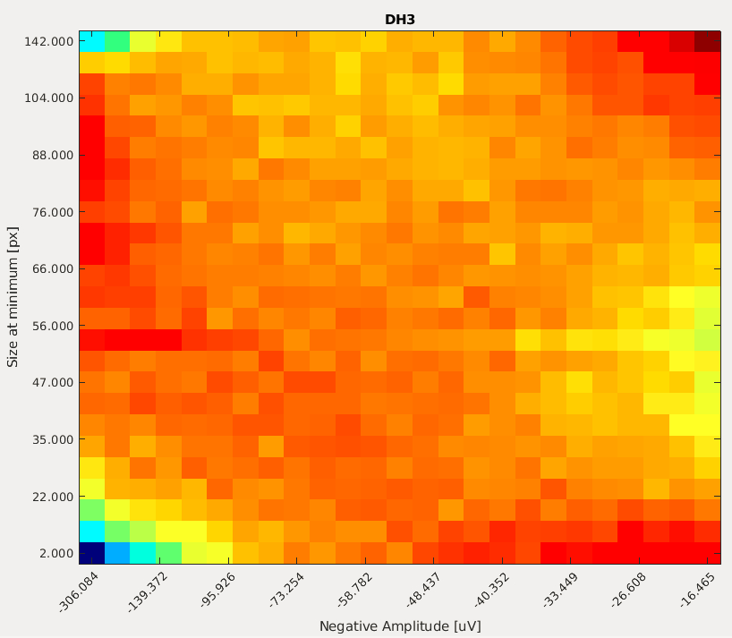
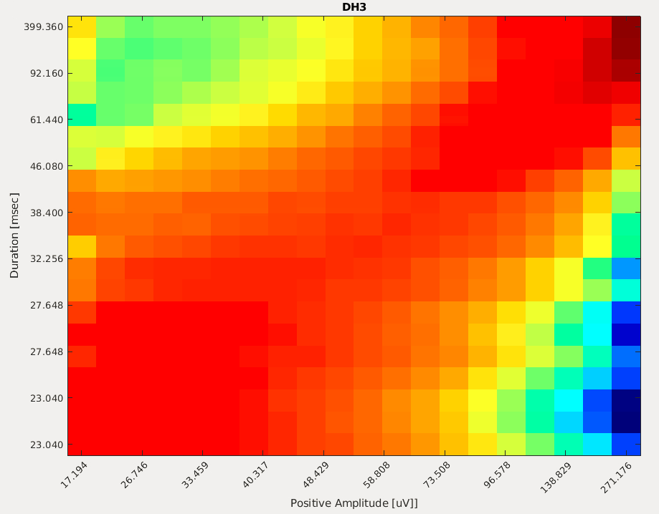
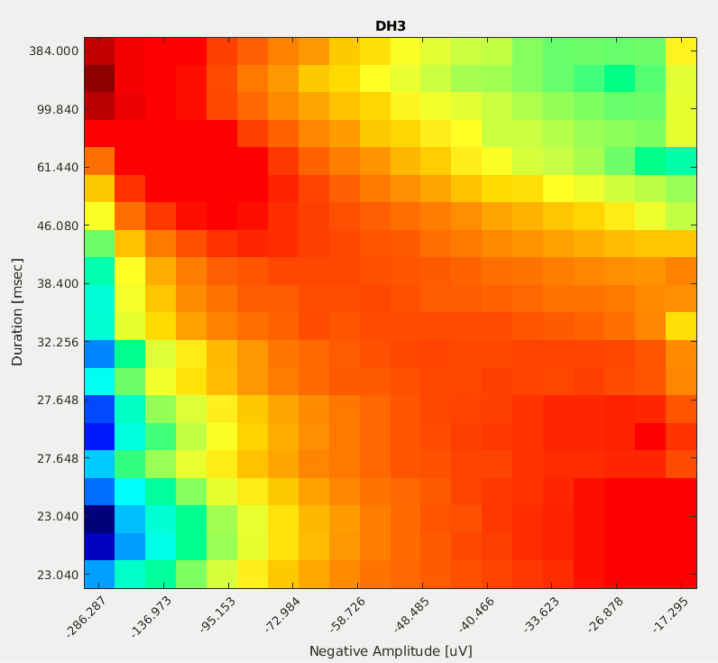
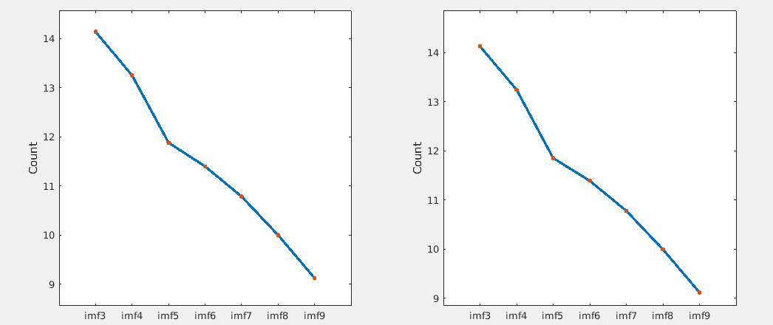
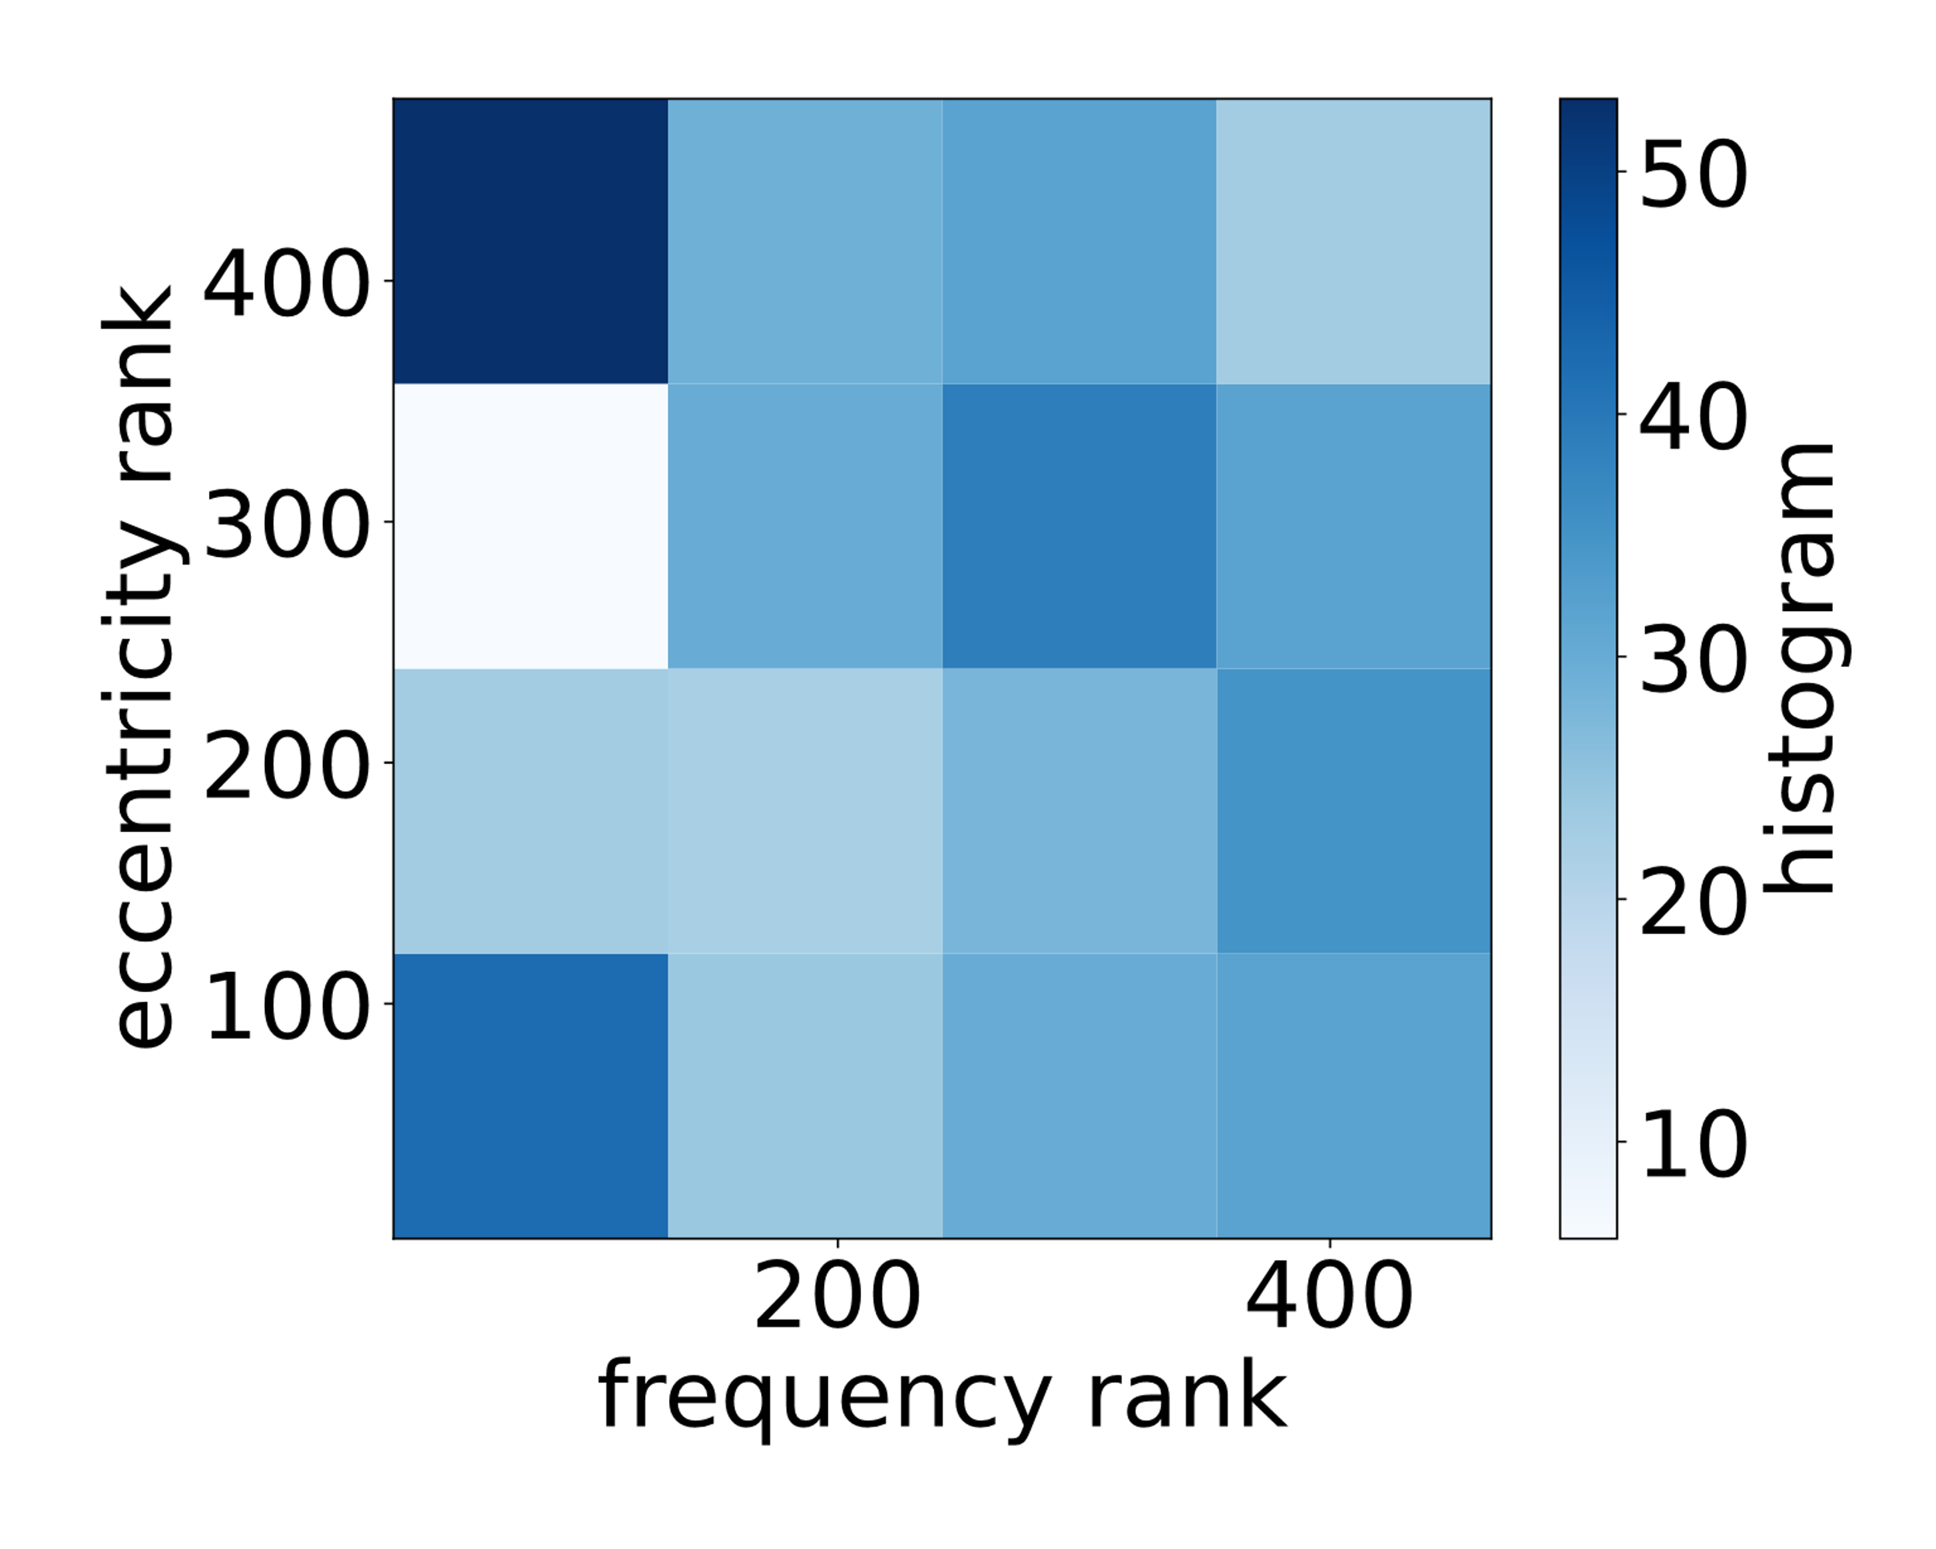
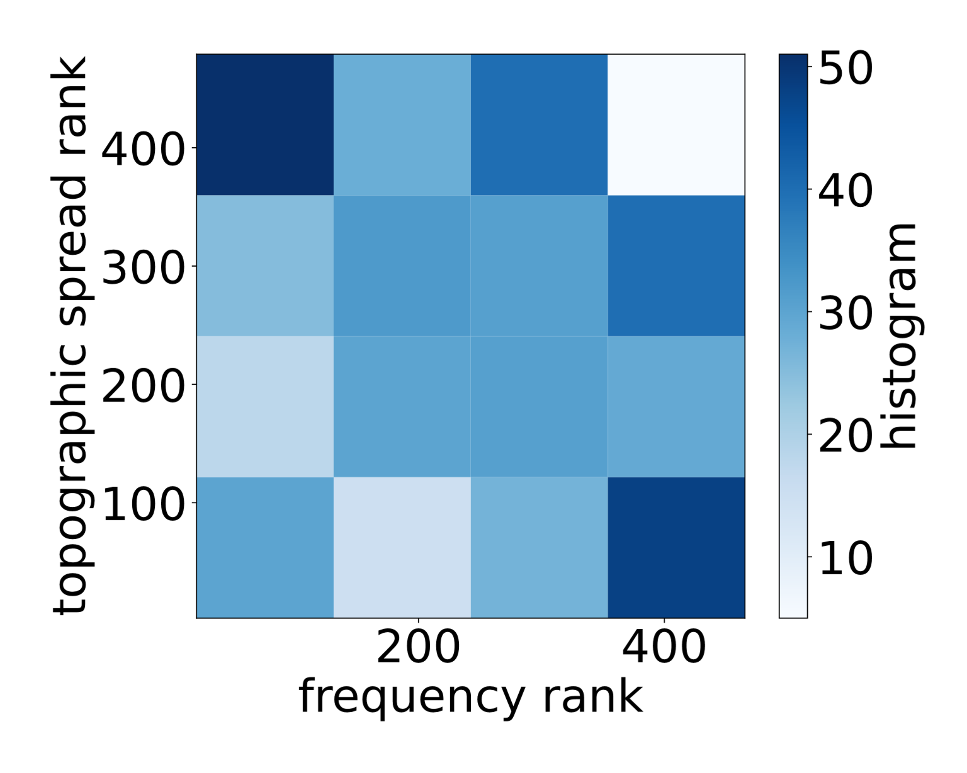
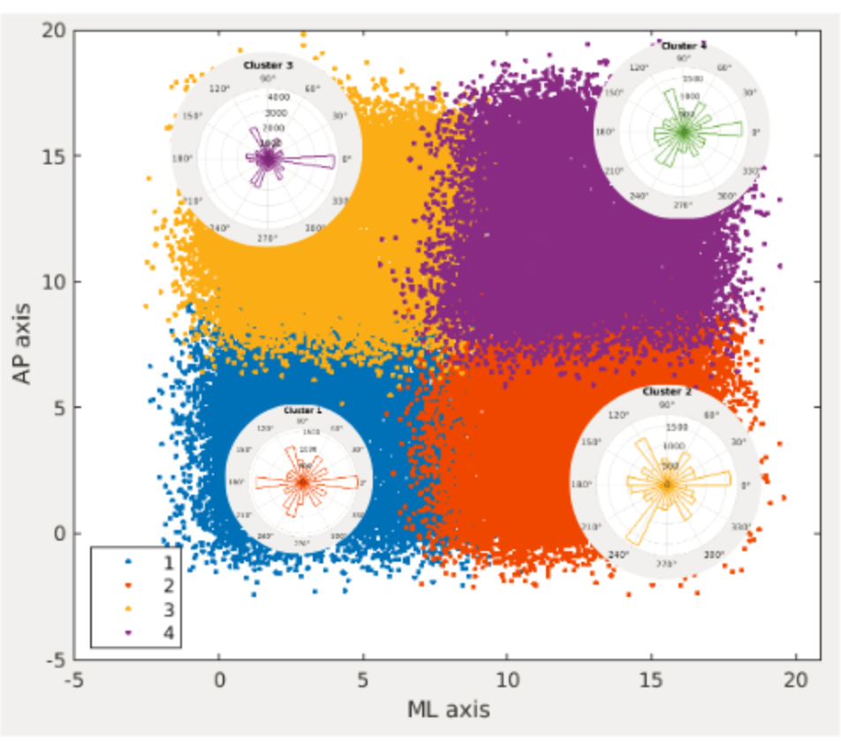
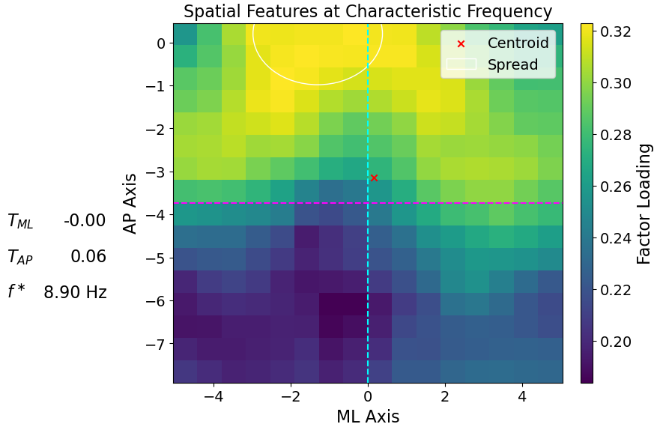
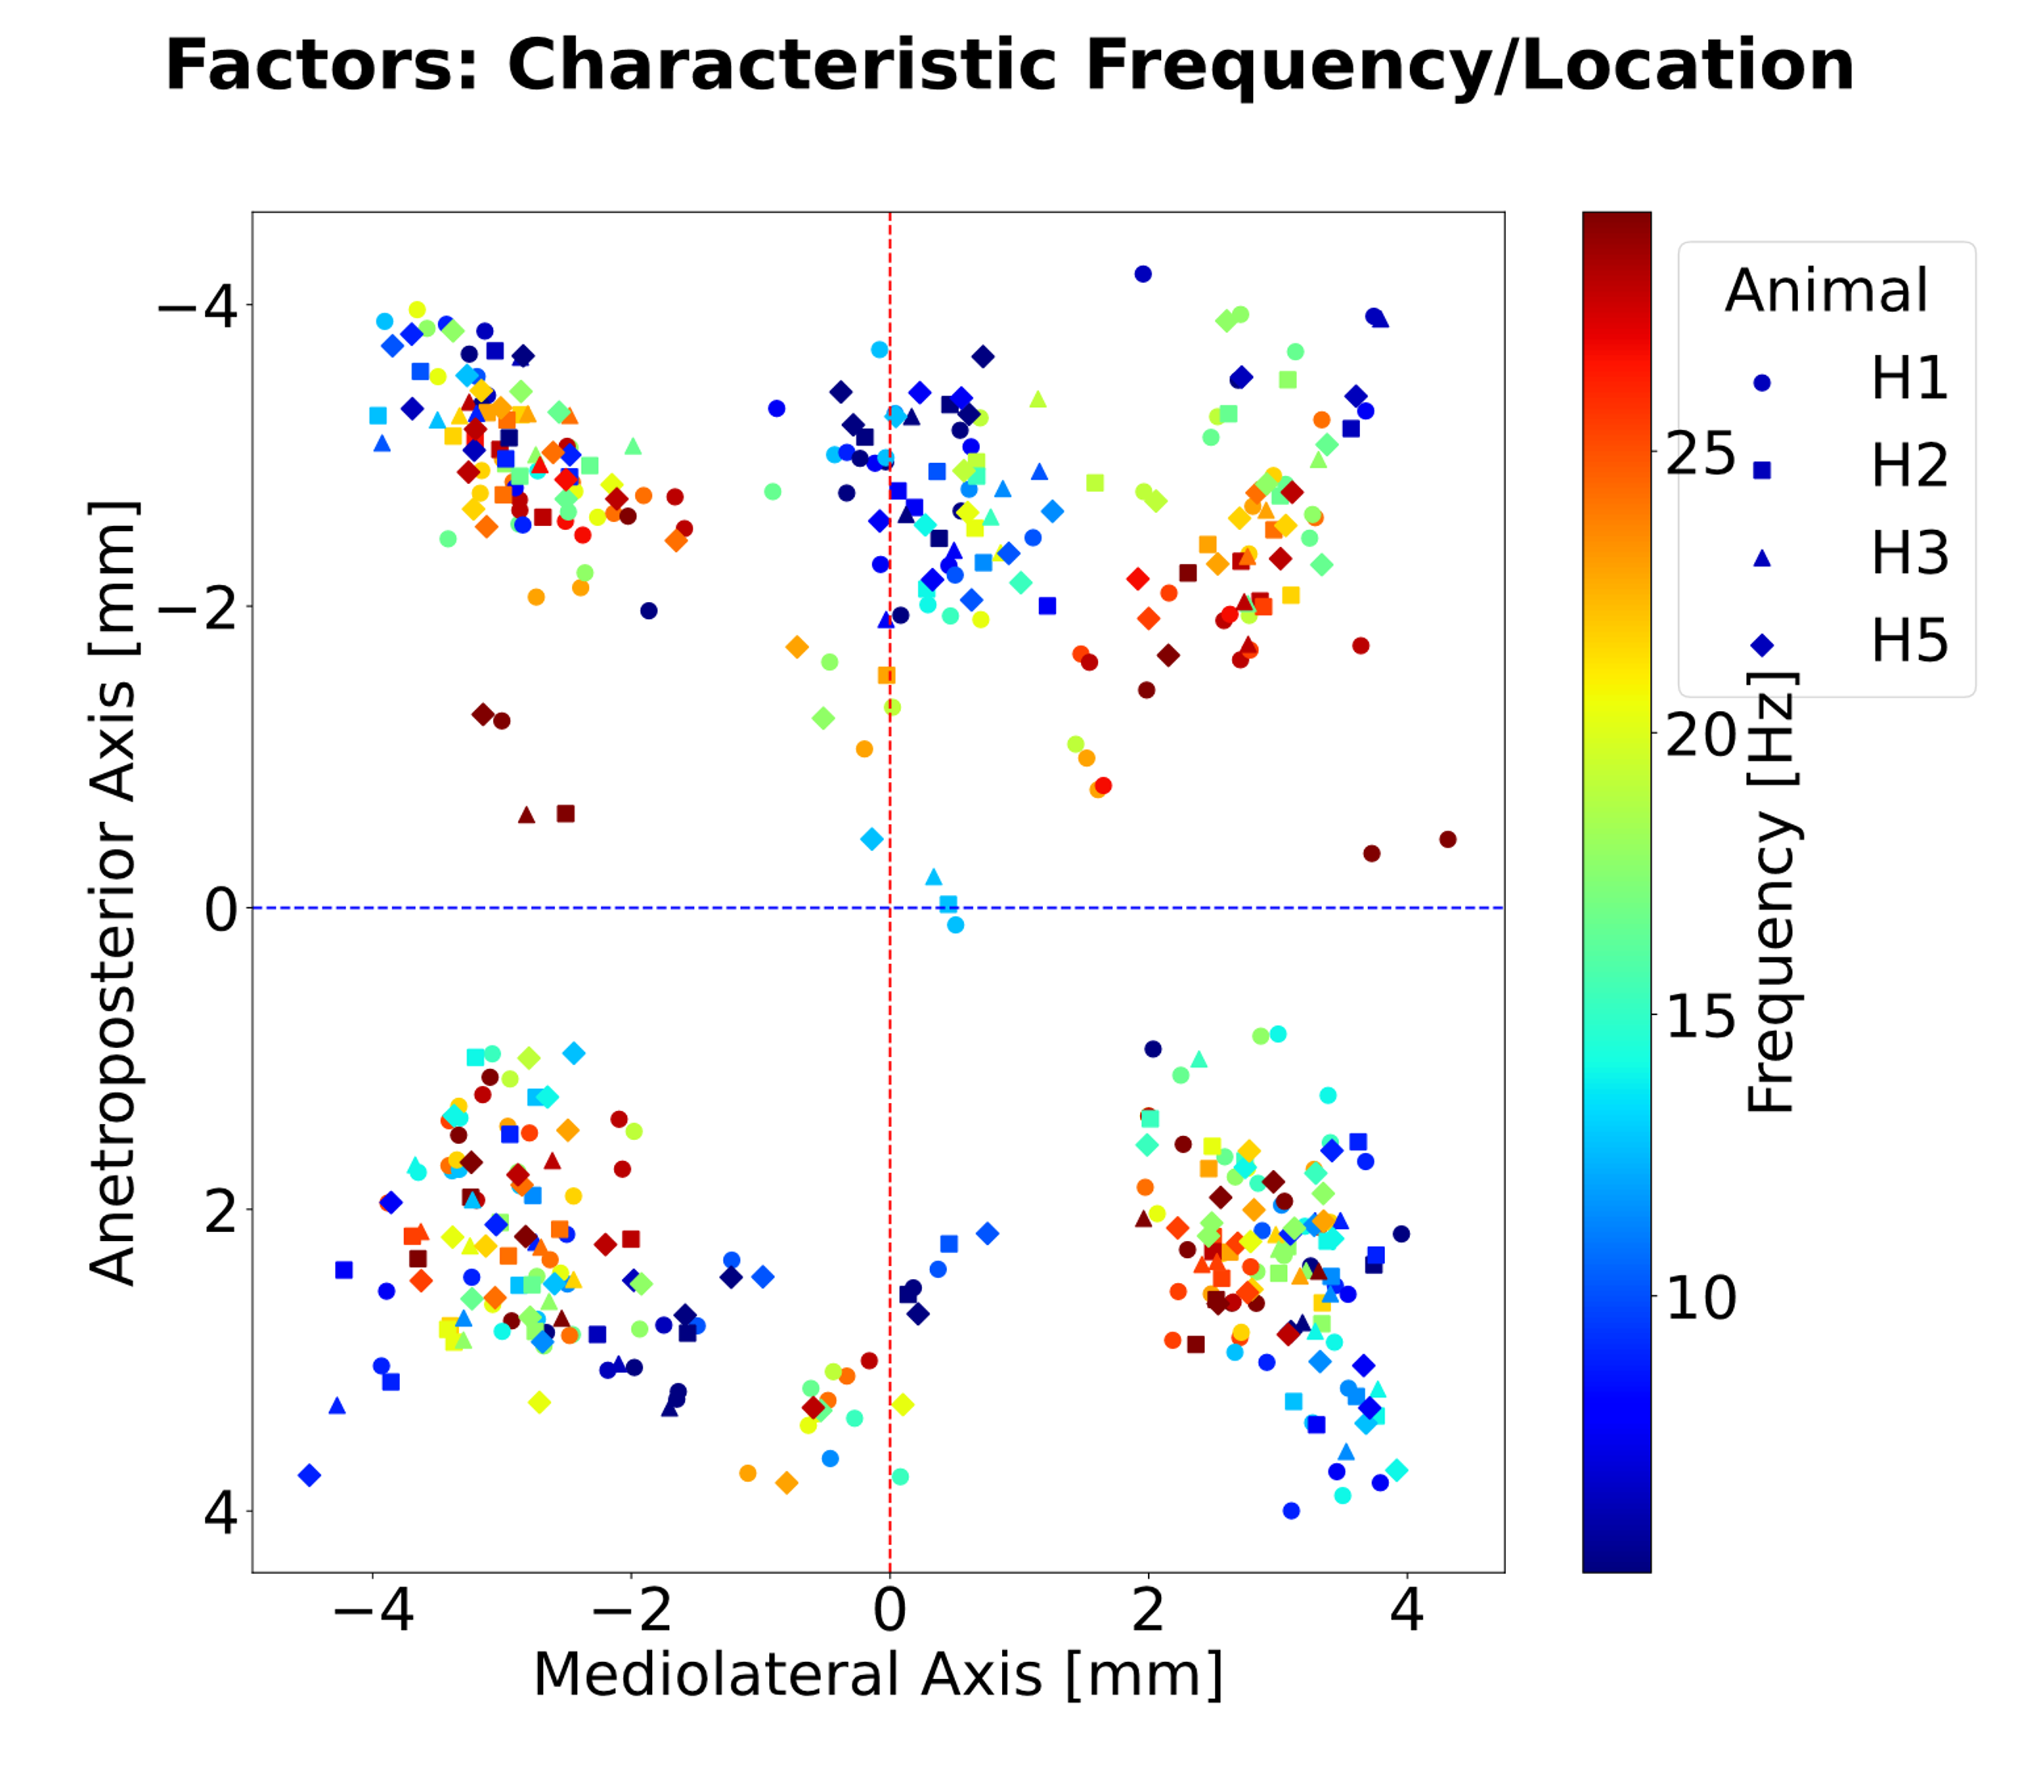
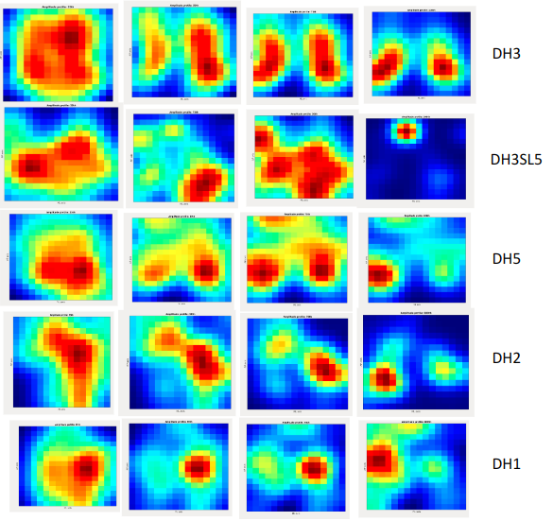
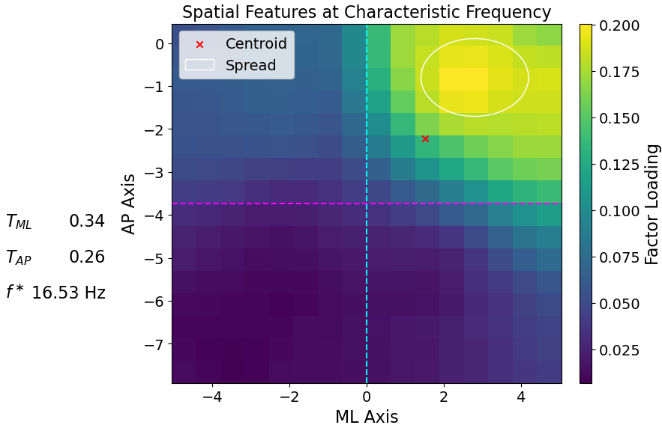




Cortex-wide high-density ECoG recordings reveal rich broad-band spatio-temporal dynamics
Ramon García Cortadella, Gerrit Schwesig, Arash Shahidi, Anna Umurzakova, Anton Sirota (LMU)
Nathan Schaefer, Jose Garrido (ICN2, Spain).
Introduction
Are cortical oscillations emerging from spatially invariant and periodically active sources?
What are the topographic generators of the cortical oscillations across different frequency bands?
With cortex-wide chronic recordings via graphene transistor arrays in rats we show that wide-band cortical LFP dynamics is spatio-temporally highly variable at a single cycle time scale. We illustrate some aspects of this phenomenon using:
Delta waves, Sleep spindles
Methodology
Graphene transistor arrays
Behaviour and state segmentation
Graphene-based solution-gated field-effect transistors (g-SGFETs) have proven to be highly suitable for DC-coupled and chronic recordings with high SNR ratio across wide frequency range.
Upscaling active graphene probes is crucial to capture large-scale spontaneous cortical dynamics with desired resolution.
Electrophysiological recordings were performed in combination with high-precision motion capture for the classification of brain.
Brain state segmentation based on spectral power across all channels of the active probe array. It, thus, includes region-specific features for more accurate and robust classification. Classification was performed on principal components.
Wave Detection Workflow
Subcycle Dynamics
To investigate wide-band cortical activity on a single-cycle basis, we bridge spatial and temporal dimensions by:
Detecting local extrema in 2D surface of ECoG
Concatenating contiguous spatial extrema into unitary events (i.e. waves) in time
Top panels show an example of a positive extremum at a given time point in space (left) and in time (right) . Bottom left panels show a 2D extremum locus at 2 (successive) time points, that would be joined into a single wave. Bottom right panel shows a final convex amplitude profile of a given wave event.
Spatio-temporal statistics of wave
propagation scales with frequency
Spirals in single cycles of sleep spindles
Single-cycle sleep spindle phase map over time showing a 'pinwheel' structure of a wave that propagates in space in a rotatory manner.
Similar spatio-temporal relationships are observed across events of various spectral bands.
Events of higher frequency travel faster and further than those of lower frequency.
Empirical Mode Decomposition
Alternative Spectra: Joint Probability of frequency proxy (Hz) and Amplitude of individual waves (independent of the IMF label)
Spindle-band space-frequency factor analysis reveals diverse events that group in frequency and space
IMFs show continuously overlapping spectra and can, hence, capture non-stationary signal better without forcing them onto some basis function and limiting analysis to narrow spectral bands
infraslow
delta
spindle
slow gamma
log of the spectrum proxy for one animal (DH3). Curve fitting revealed quadratic relationship
Amplitude-Frequency Proxy Joint Probability (log transformed) as a type of spectrum estimation from wave events. Here, positive wave of DH3SL5 showing ‘spectral’/amplitude modes ~ 3-4 Hz, 13 Hz, 18-20 Hz and 40 Hz
Pairwise feature comparisons of accumulated wave events; Basic characteristics and relationships
Joint probabilities are uniform transformed to visualize the relationships better as heavily biased by differences in event numbers in different bins (i.e. 1/f adjacent relationship)
1/f distribution of IMF counts
Spectral and Topographic organization of Spindle Modes
"Topographic Origins and Propagation Directions
Delta-band event spatial density
Direction of propagation of Spindle Modes
Lower frequency oscillations are more eccentric and have wider topographic extent
variable across animals, consistent within. Common large amplitude mode that is bilateral and posterior.

